Slide 1
AVL Tree
By Mostafa Saad

Slide 2
AVL Tree
Why? What?
Basic Idea
Balance Examples
Balance Factor
Tree Rotation 4 cases

Slide 3
AVL Tree
30
In BST, we said when data are almost sorted, The shape is like a branch
The problem is all operations are O(N)
25
20
15
10

Slide 4
AVL Tree
We wish a tree be balanced
Its height is minimal
Minimal height is log(N)
20
25
15
30
10

Slide 5
AVL Tree
To solve this problem, many binary trees were proposed to solve this problem automatically
These trees are called balanced binary search trees
One of the first and simplest trees is AVL tree

Slide 6
AVL Tree
AVL says ONCE a tree is unbalanced, we simply find our way to rebalance it
In AVL, this is highlighted when the difference between smallest root-leaf path and biggest one > 2

Slide 7
AVL Balanced Example
15
10
20
7
12
16
Longest Path (e.g. 15-20-16) = 2 steps
Shortest path (e.g. 15-10-7)= 2 steps
Longest – Shortest = 0 < 2

Slide 8
AVL Balanced Example
15
10
20
7
12
16
13
Longest Path (e.g. 15-10-12-13) = 3 steps
Shortest path (e.g. 15-10-7)= 2 steps
Longest – Shortest = 1 < 2

Slide 9
Best Balanced Example
13
10
16
7
12
16
20
Note, the optimal tree could be built by centralizing the numbers when are sorted in BST
However, AVL doesn’t care when difference = 0 or 1

Slide 10
AVL Unbalanced Example
15
10
20
7
12
16
13
14
Longest Path (e.g. 15-10-12-13-14) = 4 steps
Shortest path (e.g. 15-10-7)= 2 steps
Longest – Shortest = 2< 2 => unbalance

Slide 11
AVL tree
To detect the unbalance, we calculate the balance factor
Lead node factor = 0
balance factor = left height – right height
If factor > 1, left is bigger
If factor < -1, right is bigger

Slide 12
AVL Balance Factor
15
Bf = 3-2=1
Bf = 1-2=-1
20
Bf = 1-0=1
10
Bf = 0
Bf = 0
Bf = -1
16
7
12
Bf = 0
13
The factor helps us to know if there is a problem or not
And if there is a problem whether on left (+ve) or right (-ve)

Slide 13
AVL tree
Once we added a node, we goes up and update the BF, once |BF| > 1, we know we have a problem starting from this node, then we fix it.
To rebalance, we apply tree rotation concept

Slide 14
AVL Balance Factor
15
10
20
Bf = 0
7
12
Bf = -2
16
13
Bf = -1
14
Bf = 0

Slide 15
AVL Balance Factor
15
Bf = 1
10
20
Bf = -1
7
12
Bf = 0
16
13
14
Bf = 0
Bf = 0

Slide 16
Binary Tree rotation
A change in the structure without interfering with the order of the elements
Typically moves one node up in the tree and one node down
Popular usage: decrease tree height by moving smaller subtrees down and larger subtrees up

Slide 17
Think in 3 nodes => 5 cases
Bf = 2
5
3
Bf = -2
Bf = 2
5
3
Bf = -2
Bf = 1
4
Bf = -1
4
3
Bf = -1
Bf = 1
5
5
3
4
4
1-Left Left
2-Right Right
3-Left Right
4-Right Left
+ve => Left
-ve => Right
4
Left rotation over (3-4) in case 3
Convert it to Case 1
3
5
Right rotation over (4-5) in case 3
Convert it to Case 2

Slide 18
In a bigger tree
In a bigger tree, each node of the 3 might have 0-2 children.
When doing the balance, make sure the sub-trees are re-allocated without violating a BST

Slide 19
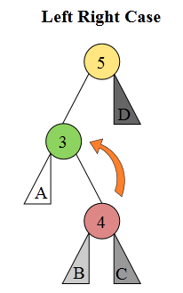
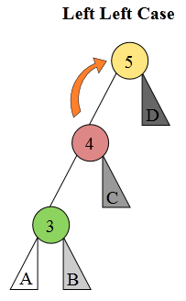
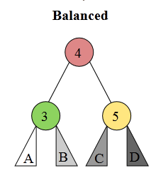
LR => LL => B
Left Rotation
Right Rotation
Imagine that: A, B, C, D are possible 4 sub-trees
We would like to do rotations to balance the 3 nodes causing a problem
But keep the BST property correct
You may think: A = 2, B = 3.5, C = 4.5, D = 6
Notes:
Image Src: http://upload.wikimedia.org/wikipedia/commons/f/f5/AVL_Tree_Rebalancing.svg

Slide 20
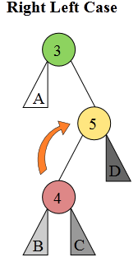
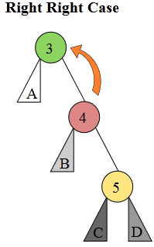
RL => RR => B
Right Rotation
Left Rotation
If you checked to the A, B, C, D order in the 3 shapes, you will find them sorted
Notes:
Image Src: http://upload.wikimedia.org/wikipedia/commons/f/f5/AVL_Tree_Rebalancing.svg

Slide 21
The general flow
Now, we are ready for a full example trace
The flow is simple
1- Add the element to the BST in normal way
2- Let current node = just added one
3- Calculate BF
4- if |BF| > 1, we have an AVL unbalance
If we are in case (3 or 4), convert to case (1 or 2)
If new in case 1 or 2, handle them
Let current node = parent
Go to 3

